Slide 1
OMOP Common Data Model Extract, Transform & Load Tutorial

Slide 2
What this tutorial will provide . . .
Suggested process for developing a CDM ETL
OHDSI ETL tools: White Rabbit, Rabbit-In-A-Hat, and Usagi
Resources like the Book of OHDSI and THEMIS
Generation of a simple ETL examples

Slide 3
Agenda
Time | Agenda Item
9:00-9:30 | Overview
9:30-10:45 | ETL Step 1 – Design Your ETL
10:45-11:15 | Break
11:15-12:00 | ETL Step 2 – Mapping to the Vocabulary
12:00-1:00 | Lunch
1:00-1:30 | ETL Step 2 – Mapping to the Vocabulary (continued)
1:30-3:00 | ETL Step 3 – Develop ETL
3:00-3:30 | Break
3:30-4:15 | ETL Step 4 – Quality Control
4:15-4:45 | ETL Step 5 – ETL Maintenance
4:45-5:00 | ETL Pain Points & Conclusions

Slide 4

Ground Rules
We have build in some decent sized breaks, please return before times up
We are recording this presentation for future use
We may take some questions off-line if too specific

Slide 5




Instructors
Clair Blacketer | Erica A. Voss
Evanette K. Burrows | Maxim Moinat

Slide 6
Connecting to the Hotel WIFI
Network: OHDSISYMP
Password: OHDSI2019

Slide 7

Follow Along
This full deck can be found here:
https://github.com/OHDSI/Tutorial-ETL
Materials → OMOP Common Data Model Extract, Transform & Load.pptx

Slide 8






OHDSI in a Box
Raw Lauren
PostgreSQL
CDM Lauren (EMPTY)
cdm
webapi
Atlas
Raw Synthea
WebTools
WebAPI
CDM Synthea v1.0
PGAdmin4
Tomcat
CDM Synthea v2.0
Methods Library
CDM Synpuf (100K)
OHDSI R packages
Studio
WhiteRabbit
Usagi

Slide 9

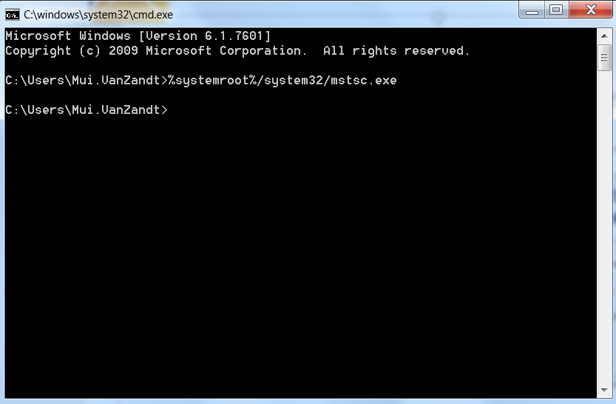
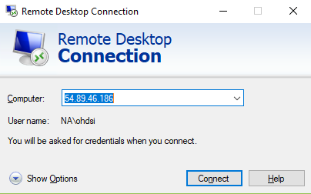
How to Sign into the Remote Desktop
From your command prompt, type %systemroot%/system32/mstsc.exe to launch Remote Desktop

Slide 10
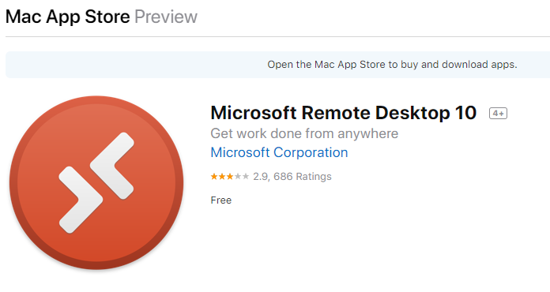
How to Sign into the Remote Desktop

Slide 11
How to Sign into the Remote Desktop
Use the shortcut on the desktop named “Remote Desktop”
URL TBD
Pick one of the rows and put your name on the second column

Slide 12
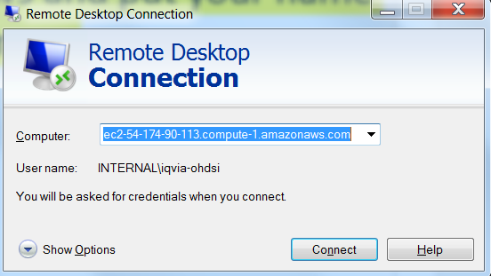
How to Sign into the Remote Desktop
Take Column A from spreadsheet and copy into the “Computer” field

Slide 13
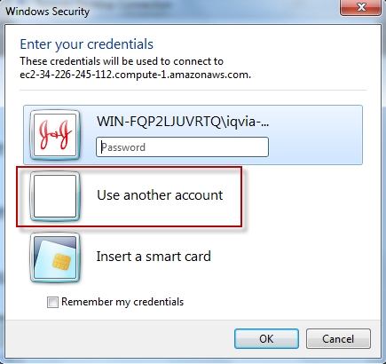
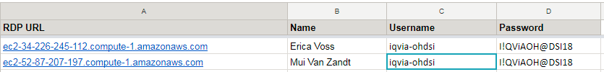
How to Sign into the Remote Desktop
Pick ‘Use Another Account’
Copy username from Column C
Copy password from Column D

Slide 14
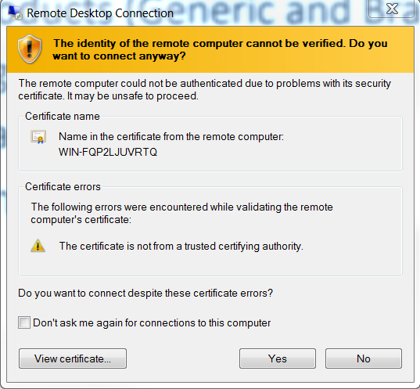
How to Sign into the Remote Desktop
If you get this page, select “Yes”

Slide 15
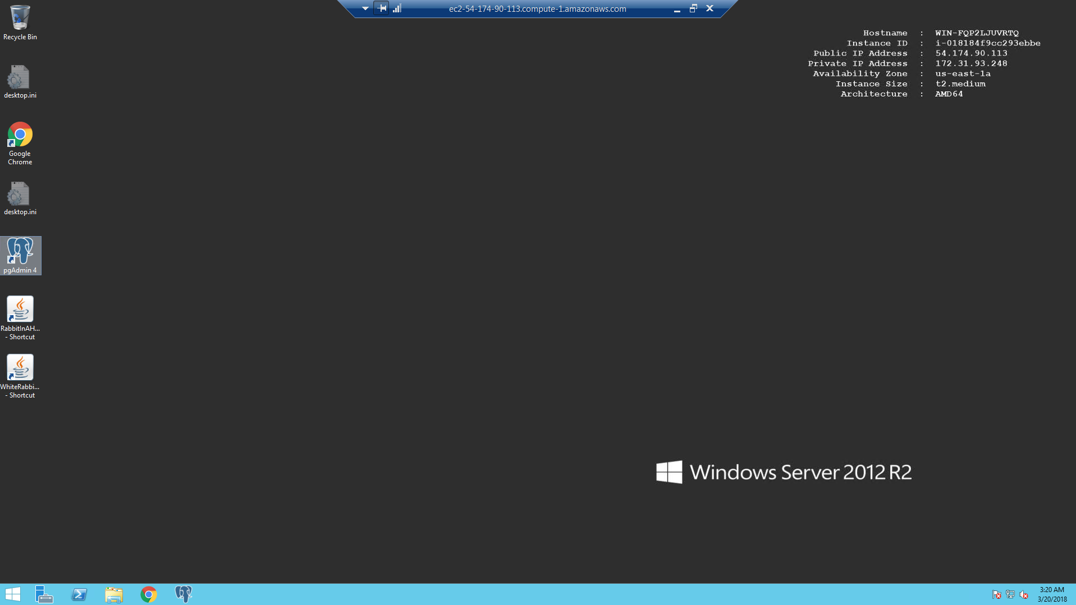
OHDSI in a Box – Ready

Slide 16
OHDSI’s Mission & Vision
To improve health by empowering a community to collaboratively generate the evidence that promotes better health decisions and better care.
A world in which observational research produces a comprehensive understanding of health and disease.
Join us on the journey
http://ohdsi.org

Slide 17

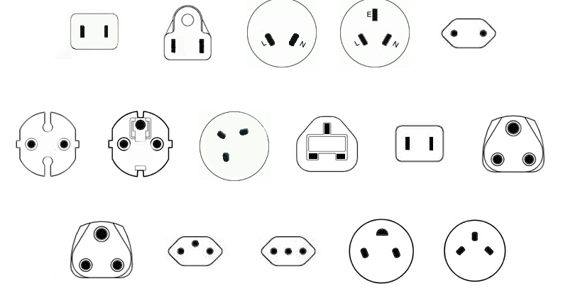
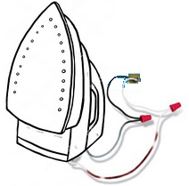
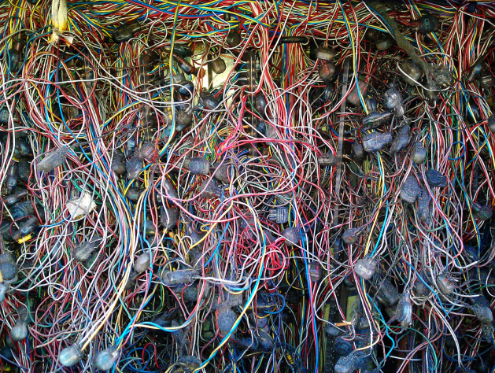
Current Approach: “One Study – One Script“
"What's the adherence to my drug in the data assets I own?"
Current solution:
Analytical method: Adherence to Drug
North America
Southeast Asia
China
Europe
UK
Japan
India
Application to data
Switzerland
Italy
Soouth Africa
Israel
Not scalable
Not transparent
Expensive
Slow
Prohibitive to non-expert routine use
One SAS or R script for each study

Slide 18



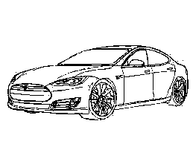
Solution: Data Standardization Enables Systematic Research
Adherence
Mortality
Source of Business
North America Southeast Asia China
Europe UK Japan India
So Africa Switzerland Italy Israel
Safety Signals
Standardized data
OHDSI Tools OMOP CDM

Slide 19
CDM Version 6 Key Domains
Person
Standardized health system data
Standardized metadata
Observation_period
CDM_source
Location
Standardized vocabularies
Visit_occurrence
Metadata
Location_history
Visit_detail
Standardized derived elements
Care_site
Condition_occurrence
Provider
Drug_exposure
Concept
Procedure_occurrence
Vocabulary
Device_exposure
Condition_era
Standardized clinical data
Domain
Drug_era
Measurement
Concept_class
Dose_era
Note
Standardized health economics
Concept_relationship
Results Schema
Note_NLP
Cohort
Relationship
Survey_conduct
Cohort_definition
Concept_synonym
Observation
Concept_ancestor
Specimen
Cost
Source_to_concept_map
Fact_relationship
Payer_plan_period
Drug_strength

Slide 20
Why the CDM?
Ability to pursue cross-institutional collaborations
Write one program to run on multiple data assets
OMOP Vocabularies has greatly increased our ability to find relevant codes
You truly know your data if you convert it to the CDM
If you know a problem with your data, you can use the ETL to address it
Whole community of researchers across diverse organizations and countries
You can use standardized tools developed by OHDSI like ATLAS and the Patient Level Prediction Package
The CDM brings consistency to observational research through
standardization of many of its components
Buy vs Build: leverage an entire community of technical and scientific capability for “free”
Takes observational research towards open science

Slide 21
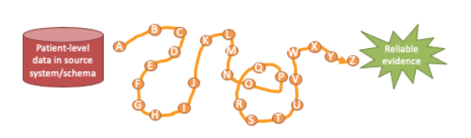
ETL
Extract, Transform, Load
In order to get from our native/raw data into the OMOP CDM we need to design and develop and ETL process
Goal in ETLing is to standardize the format and terminology
This tutorial
Will teach you best practices around designing an ETL and CDM maintenance
Will not teach you how to program an ETL

Slide 22









ETL Process
ETL Documentation
ETL
Data experts and CDM experts together design the ETL
People with medical knowledge create the code mappings
All are involved in quality control
A technical person implements the ETL
OHDSI Tools
White
Rabbit
Rabbit In a Hat
Usagi
White
Rabbit
ACHILLES
DQD
Rabbit In a Hat

Slide 23

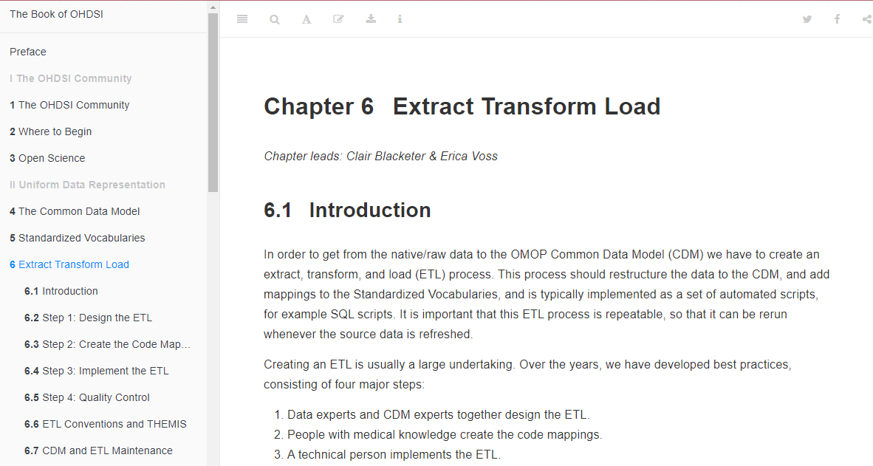
ETL Process
https://ohdsi.github.io/TheBookOfOhdsi/ExtractTransformLoad.html

Slide 24

Hands On Exercises for Today
Scan a database with White Rabbit
Practice building an ETL document with Rabbit in a Hat
Mapping Source Codes by with the OMOP Vocabulary and USAGI

Slide 25
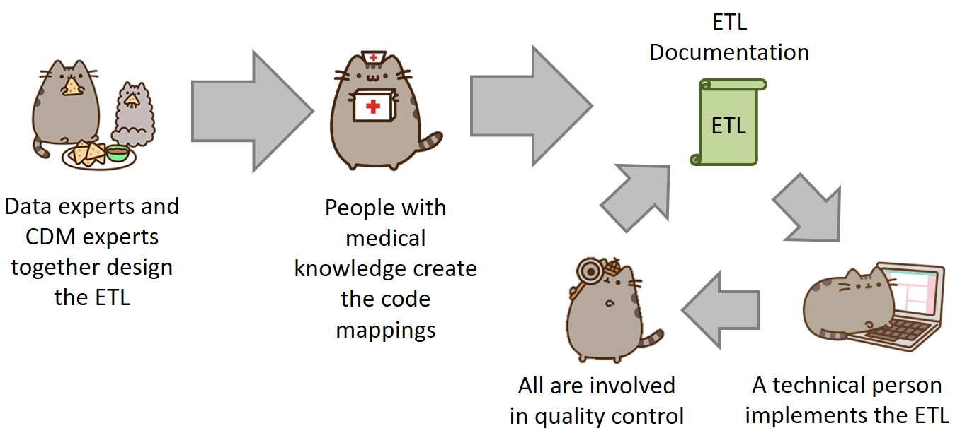

Slide 26



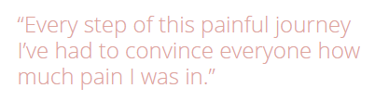
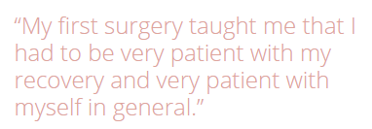
A Patient’s Story: Lauren
https://www.endometriosis-uk.org/laurens-story

Slide 27
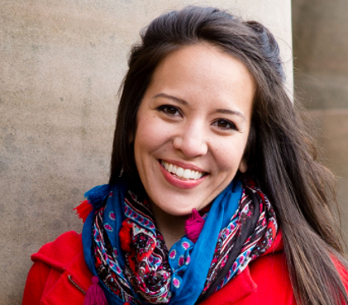
What data do we have?
dysmenorrhea
abdominal pain
missed work
missed work
acetaminophen
acetaminophen
acetaminophen
GP visit
ultrasound
pelvic exam
cyst of ovary
Hospital Visit
severe pain
temp 103°F
CT Scan
ambulance
Bloated abdomen
ascites
surgery
endometrioma
Lauren’s Timeline
Endometriosis
/ /
/ /
-3 Years
-2 Years
-1 Years
-2 Weeks
-3 Days
Day 0

Slide 28
Data Format
SyntheaTM is a Synthetic Patient Population Simulator. The goal is to output synthetic, realistic (but not real), patient data and associated health records in a variety of formats.
The resulting data is free from cost, privacy, and security restrictions. It can be used without restriction for a variety of secondary uses in academia, research, industry, and government (although a citation would be appreciated).
https://github.com/synthetichealth/synthea
Walonoski J, Kramer M, Nichols J, Quina A, Moesel C, Hall D, Duffett C, Dube K, Gallagher T, McLachlan S. Synthea: An approach, method, and software mechanism for generating synthetic patients and the synthetic electronic health care record. J Am Med Inform Assoc. 2017 Aug 30. doi: 10.1093/jamia/ocx079. [Epub ahead of print] PubMed PMID: 29025144.

Slide 29
Synthea Tables
File | Description
allergies.csv | Patient allergy data.
careplans.csv | Patient care plan data, including goals.
conditions.csv | Patient conditions or diagnoses.
encounters.csv | Patient encounter data.
imaging_studies.csv | Patient imaging metadata.
immunizations.csv | Patient immunization data.
medications.csv | Patient medication data.
observations.csv | Patient observations including vital signs and lab reports.
organizations.csv | Provider organizations including hospitals.
patients.csv | Patient demographic data.
procedures.csv | Patient procedure data including surgeries.
providers | Clinicians that provide patient care.

Slide 30
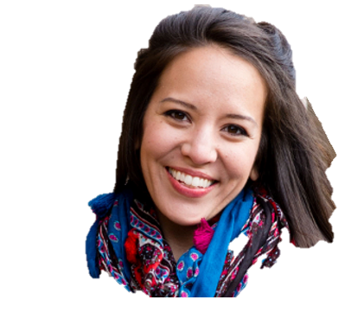
Raw Data
raw_lauren
raw_synthea
1 Patient
Lauren Data
Synthea Format
1000 Patient
Synthetic Data
Synthea Format

Slide 31
Tools help us get started . . .
White Rabbit
Rabbit In a Hat
performs a scan of the source data, providing detailed information on the tables, fields, and values that appear in a field
Uses White Rabbit scan to provide a graphical user interface to help build an ETL document
Does not generate code* *But people are test driving this

Slide 32
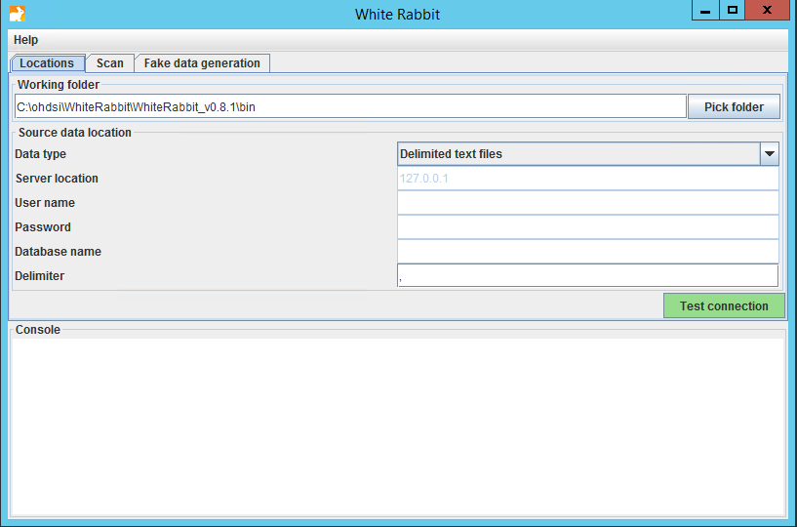
White Rabbit - Location

Slide 33
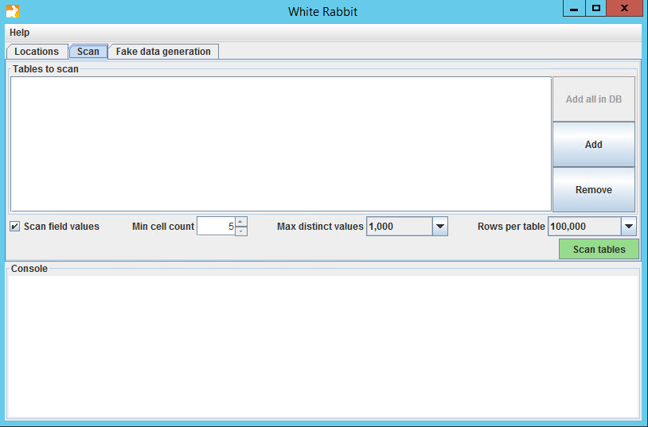
White Rabbit - Scan

Slide 34
White Rabbit - Scan

Slide 35
White Rabbit - Scan

Slide 36
White Rabbit – Scan Report
raw_synthea
We already ran the scan on raw_synthea
To open the scan while we review:
https://github.com/OHDSI/Tutorial-ETL
Materials → WhiteRabbit → ScanReport_raw_synthea.xlsx
Click “View Raw” to download the XLSX

Slide 37
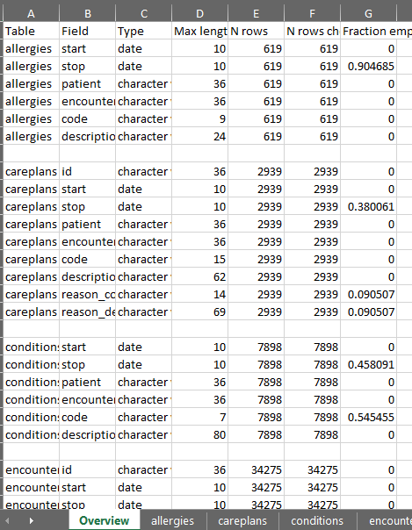
White Rabbit – Scan Report: raw_synthea
Overview Tab

Slide 38
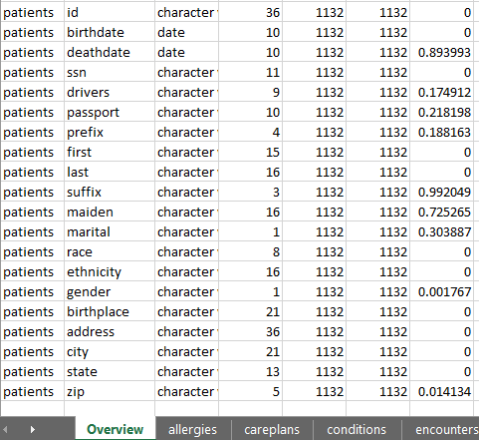
White Rabbit – Scan Report: raw_synthea
Overview Tab

Slide 39
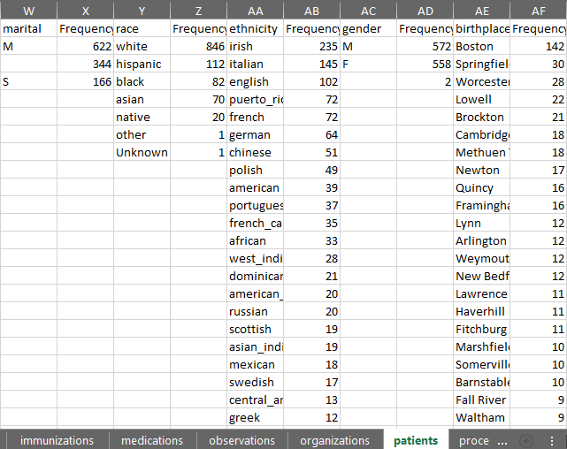
White Rabbit – Scan Report: raw_synthea
Patients Tab
Notes:
Ethnicity = (Hispanics and Non-Hispanics)
Race = (white, black, Asian, native, other, unknown)

Slide 40
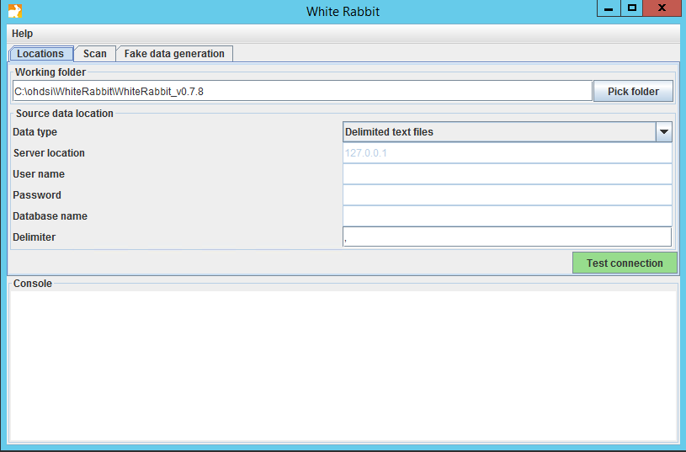
Now Your Turn: Scan Lauren’s Data
Click on WhiteRabbit shortcut
Go into the WhiteRabbit folder
Open bin\whiteRabbit.bat
raw_lauren

Slide 41
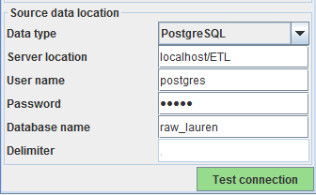
Now Your Turn: Scan Lauren’s Data
Connect to Lauren’s Data
Test connection
raw_lauren
ohdsi

Slide 42
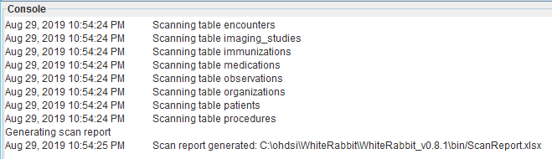
Now Your Turn: Scan Lauren’s Data
Go to the “Scan” tab
Press “Add all in DB” button, set “Min cell count” to 0, and then “Scan tables”
Open ScanReport.xlsx
raw_lauren

Slide 43
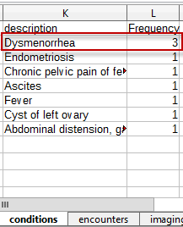

Now Your Turn: Scan Lauren’s Data
What is the most common condition Lauren has?
raw_lauren

Slide 44
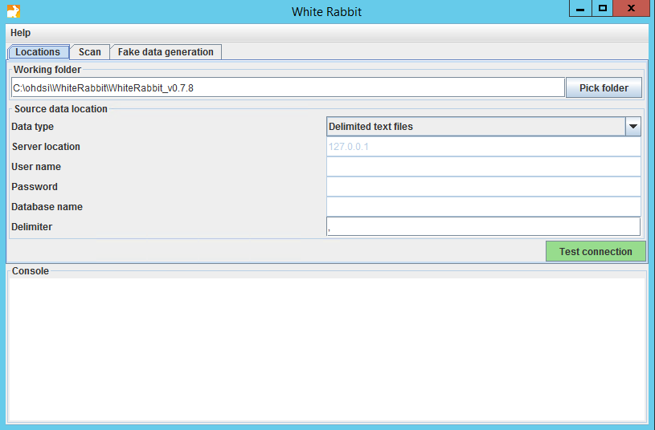
White Rabbit
White Rabbit creates an export of information about the source data
The scan can be used to:
Learn about your source data
Used by Rabbit In a Hat

Slide 45
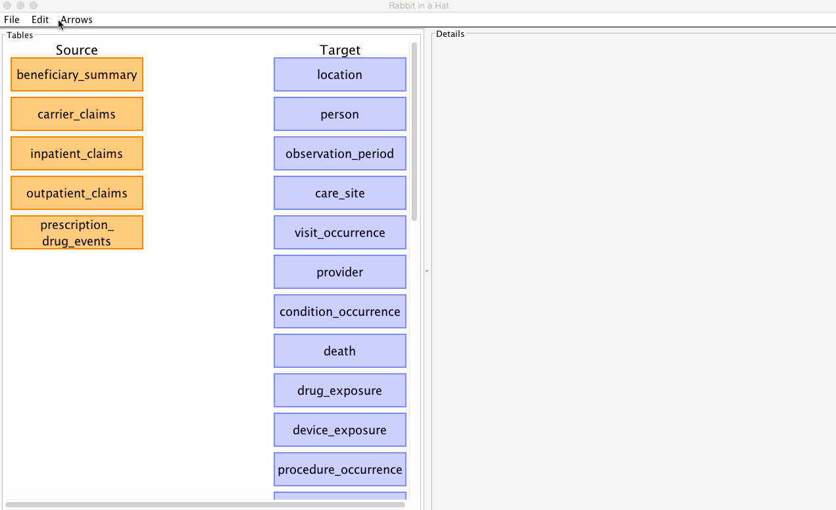
Rabbit in a Hat
Can read and display a White Rabbit scan document
Provides a graphical interface to allow a user to connect source data to tables

Slide 46
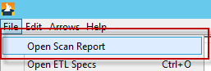
Rabbit in a Hat
raw_ synthea
We will use the ScanReport_raw_synthea.xlsx for this:
https://github.com/OHDSI/Tutorial-ETL
Materials → WhiteRabbit → ScanReport_raw_synthea.xlsx
Press the “Download” button
Save it to the desktop
Open it Rabbit in a Hat

Slide 47
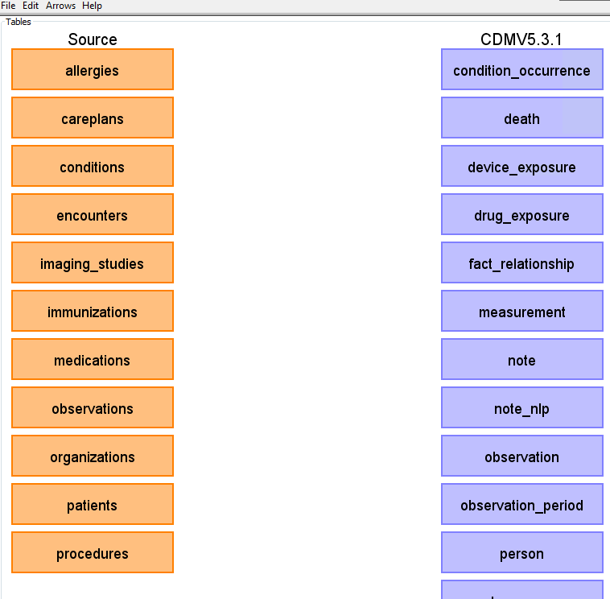
Rabbit in a Hat
The scan tells Rabbit in a Hat what is in the raw database
Orange Tables = Raw
Blue Tables = CDM

Slide 48

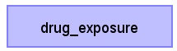
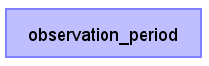

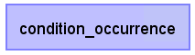
Rabbit in a Hat
Together
On your Own
Generate document
Notes:
In the condition occurrence table – we can come back to this and augment with source code mapping
Should think about how to find TYPE concepts

Slide 49

Resources
Important links to keep in mind when working on an ETL:
CDM Wiki https://github.com/OHDSI/CommonDataModel/wiki Information about the CDM structure and conventions to follow can be found here
OHDSI Forums http://forums.ohdsi.org/ http://forums.ohdsi.org/c/cdm-builders OHDSI is an active community, your questions may have already been asked on the forum however if not do not be afraid to ask it yourself!
Book of OHDSI: ETL Chapter https://ohdsi.github.io/TheBookOfOhdsi/ExtractTransformLoad.html The OHSDI community wrote the book to serve as a central knowledge repository for all things OHDSI.
THEMIS Working Group https://github.com/OHDSI/Themis

Slide 50
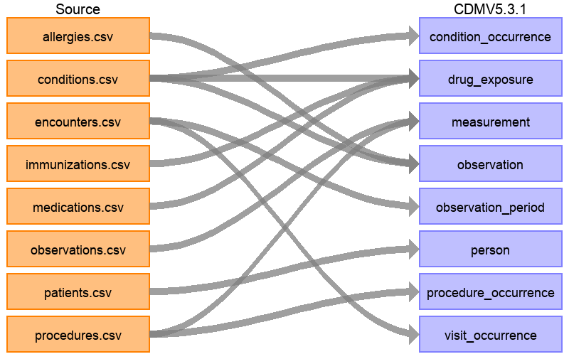
Rabbit in a Hat
The full ETL document: https://ohdsi.github.io/ETL-Synthea/
Notes:
Pull up drug exposure

Slide 51
Some Parting Thoughts On ETL
Vocabulary will tell a source record where to go.
Example, just because it is a condition code and in a condition table does not mean it will end up in CONDITION_OCCURRENCE ICD9 783.1 - Abnormal weight gain
STEM Table in Rabbit In a Hat

Slide 52
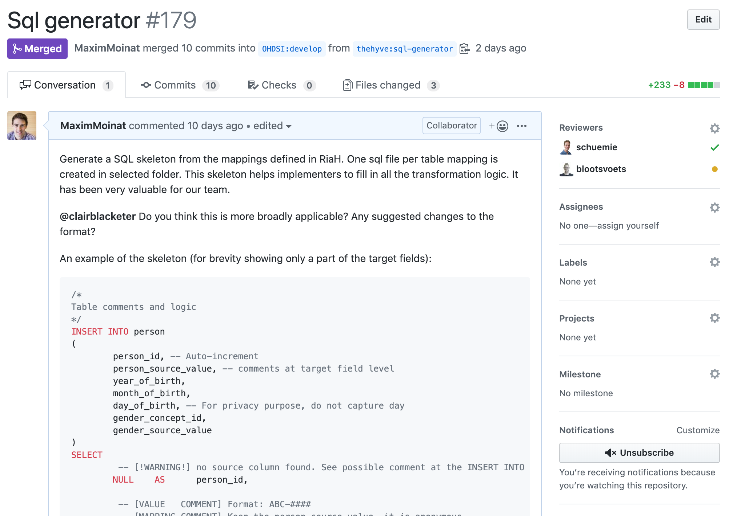
Upcoming enhancements

Slide 53
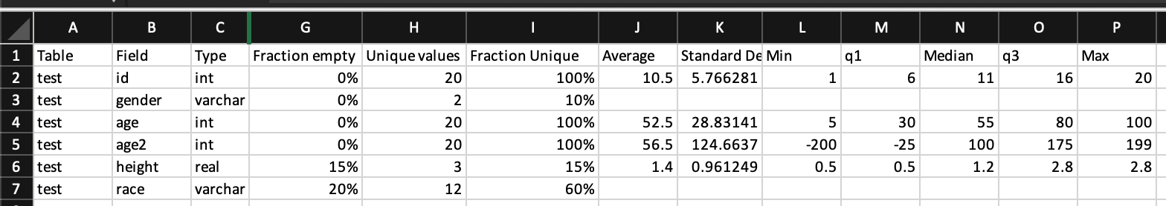
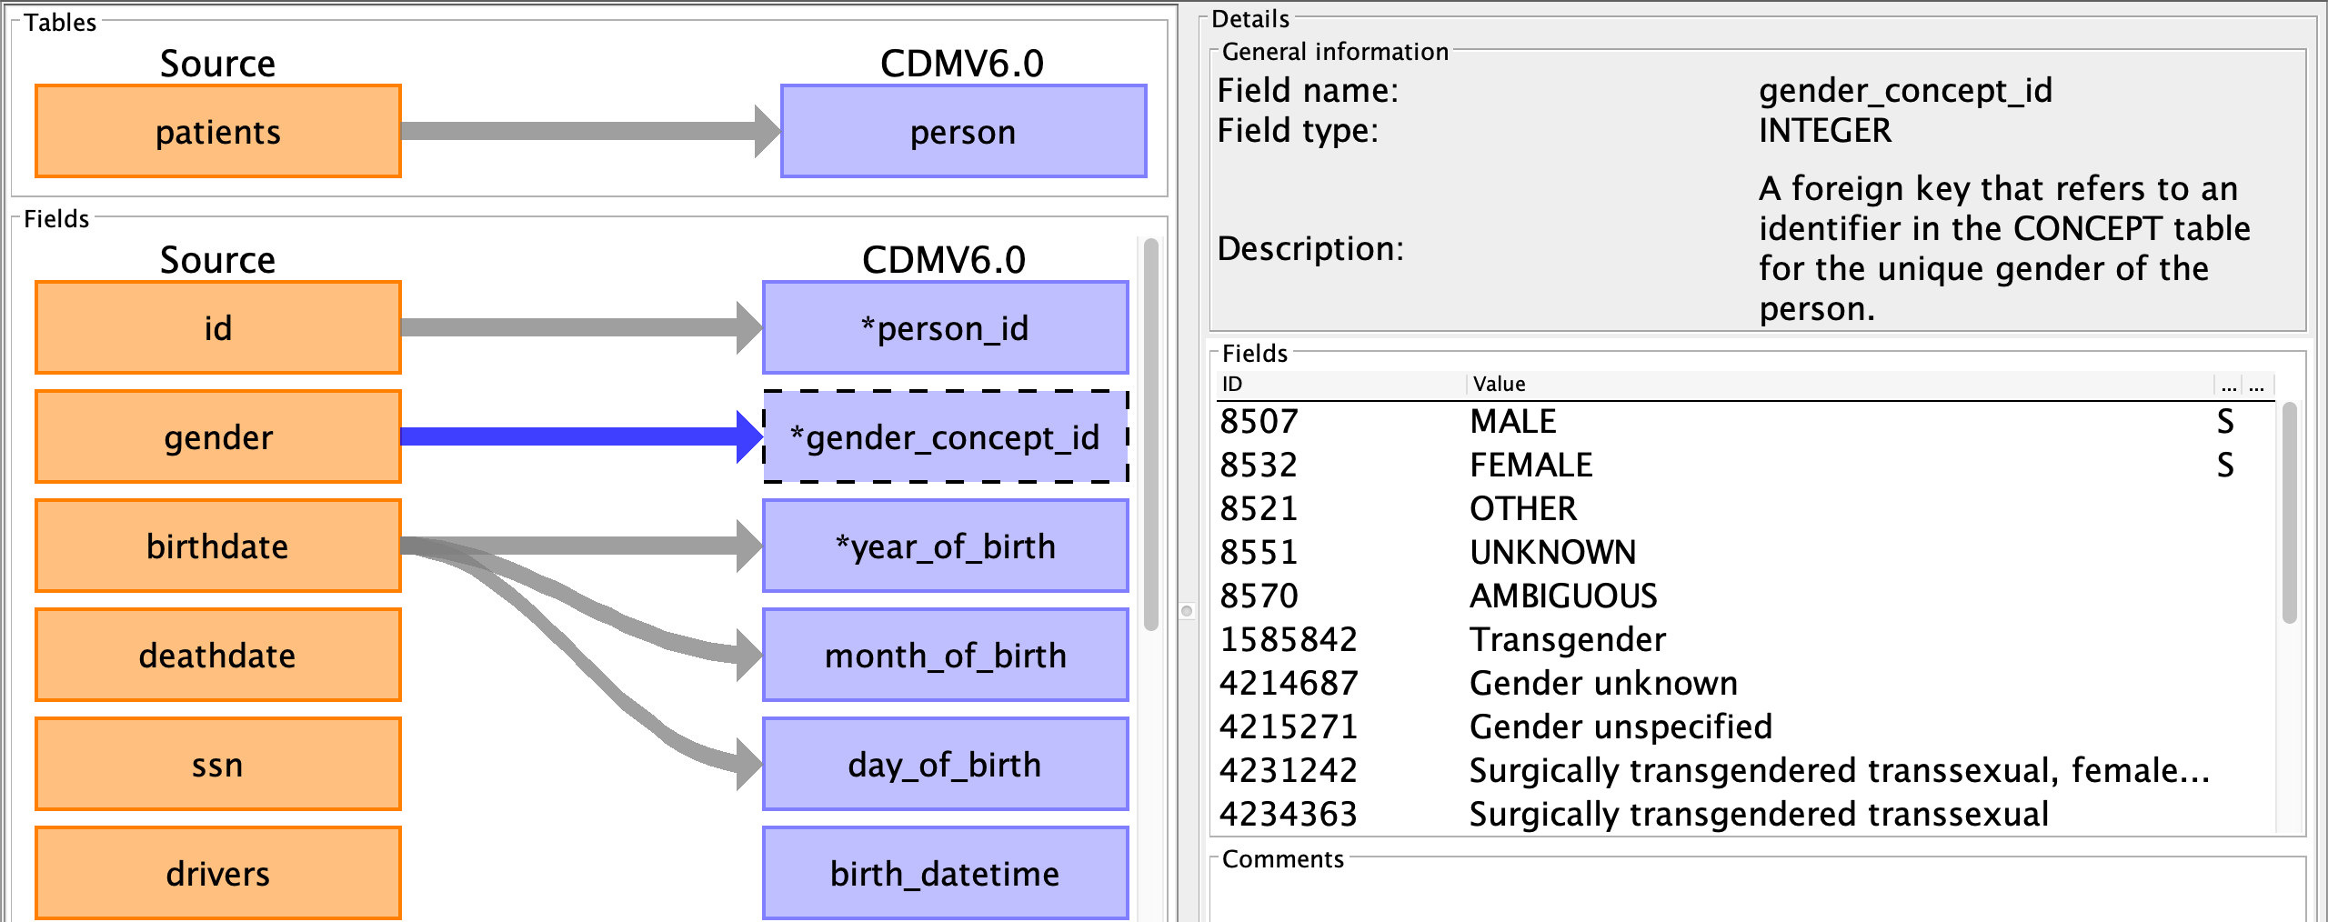
Upcoming enhancements
Additional scan report metrics
Concept id hints

Slide 54
Upcoming enhancements
Additional scan report metrics
Plus performance and user experience improvements
Concept id hints

Slide 56
Standardizing Terminologies
SOURCE_CODE
XYZ
i.e. ICPC-1 Dutch codes, ICD9, etc.
?
STANDARD_CONCEPT_ID
123456789
i.e. SNOMED for conditions and RxNorm for drugs
What is standardize:
TABLE_CONCEPT_ID standard concept the source code maps to, used for analysis
TABLE_SOURCE_CONCEPT_ID concept representation of the source code, helps maintain tie to raw data
Ways to get a source code to standard code:
OMOP Vocabulary
USAGI

Slide 57
OMOP Vocab
There are two standard queries to help us use the OMOP Vocabulary:
SOURCE_TO_STANDARD.sql
SOURCE_TO_SOURCE.sql
https://github.com/OHDSI/Tutorial-ETL
Materials → Queries

Slide 58
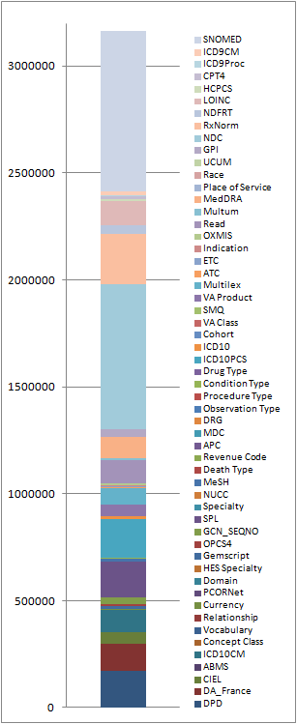
OMOP Vocab
If your source data’s codes are in the OMOP Vocab you can use it to translate to a standard
For example:
ICD9 → SNOMED
NDC → RxNORM

Slide 59
Mapping a Lauren Row to CONCEPT_ID
SELECT *
FROM RAW_LAUREN.CONDITIONS
WHERE ENCOUNTER = '70'
START | STOP | PATIENT | ENCOUNTER | CODE | DESCRIPTION
1/6/2010 |  | 1 | 70 | N94.6 | Dysmenorrhea
?
CONDITION_CONCEPT_ID | CONDITION_SOURCE_CONCEPT_ID

Slide 60
Source to Standard
WITH CTE_VOCAB_MAP AS (
SELECT c.concept_code AS SOURCE_CODE, c.concept_id AS SOURCE_CONCEPT_ID, c.concept_name AS SOURCE_CODE_DESCRIPTION,
c.vocabulary_id AS SOURCE_VOCABULARY_ID, c.domain_id AS SOURCE_DOMAIN_ID, c.CONCEPT_CLASS_ID AS SOURCE_CONCEPT_CLASS_ID,
c.VALID_START_DATE AS SOURCE_VALID_START_DATE, c.VALID_END_DATE AS SOURCE_VALID_END_DATE, c.INVALID_REASON AS SOURCE_INVALID_REASON, c1.concept_id AS TARGET_CONCEPT_ID, c1.concept_name AS TARGET_CONCEPT_NAME, c1.VOCABULARY_ID AS TARGET_VOCABUALRY_ID,
c1.domain_id AS TARGET_DOMAIN_ID, c1.concept_class_id AS TARGET_CONCEPT_CLASS_ID, c1.INVALID_REASON AS TARGET_INVALID_REASON, c1.standard_concept AS TARGET_STANDARD_CONCEPT
FROM CONCEPT C
JOIN CONCEPT_RELATIONSHIP CR
ON C.CONCEPT_ID = CR.CONCEPT_ID_1
AND CR.invalid_reason IS NULL
AND cr.relationship_id = 'Maps to'
JOIN CONCEPT C1
ON CR.CONCEPT_ID_2 = C1.CONCEPT_ID
AND C1.INVALID_REASON IS NULL
UNION
SELECT source_code, SOURCE_CONCEPT_ID, SOURCE_CODE_DESCRIPTION, source_vocabulary_id, c1.domain_id AS SOURCE_DOMAIN_ID, c2.CONCEPT_CLASS_ID AS SOURCE_CONCEPT_CLASS_ID,c1.VALID_START_DATE AS SOURCE_VALID_START_DATE,
c1.VALID_END_DATE AS SOURCE_VALID_END_DATE, stcm.INVALID_REASON AS SOURCE_INVALID_REASON,target_concept_id,
c2.CONCEPT_NAME AS TARGET_CONCEPT_NAME, target_vocabulary_id, c2.domain_id AS TARGET_DOMAIN_ID,
c2.concept_class_id AS TARGET_CONCEPT_CLASS_ID, c2.INVALID_REASON AS TARGET_INVALID_REASON,
c2.standard_concept AS TARGET_STANDARD_CONCEPT
FROM source_to_concept_map stcm
LEFT OUTER JOIN CONCEPT c1
ON c1.concept_id = stcm.source_concept_id
LEFT OUTER JOIN CONCEPT c2
ON c2.CONCEPT_ID = stcm.target_concept_id
WHERE stcm.INVALID_REASON IS NULL
)
SELECT TARGET_CONCEPT_ID, TARGET_CONCEPT_NAME, TARGET_DOMAIN_ID
FROM CTE_VOCAB_MAP
WHERE SOURCE_CODE = 'N94.6'
AND SOURCE_VOCABULARY_ID = 'ICD10CM'
AND TARGET_STANDARD_CONCEPT = 'S'

Slide 61
Source to Standard
WITH CTE_VOCAB_MAP AS (
SELECT c.concept_code AS SOURCE_CODE, c.concept_id AS SOURCE_CONCEPT_ID, c.concept_name AS SOURCE_CODE_DESCRIPTION,
c.vocabulary_id AS SOURCE_VOCABULARY_ID, c.domain_id AS SOURCE_DOMAIN_ID, c.CONCEPT_CLASS_ID AS SOURCE_CONCEPT_CLASS_ID,
c.VALID_START_DATE AS SOURCE_VALID_START_DATE, c.VALID_END_DATE AS SOURCE_VALID_END_DATE, c.INVALID_REASON AS SOURCE_INVALID_REASON, c1.concept_id AS TARGET_CONCEPT_ID, c1.concept_name AS TARGET_CONCEPT_NAME, c1.VOCABULARY_ID AS TARGET_VOCABUALRY_ID,
c1.domain_id AS TARGET_DOMAIN_ID, c1.concept_class_id AS TARGET_CONCEPT_CLASS_ID, c1.INVALID_REASON AS TARGET_INVALID_REASON, c1.standard_concept AS TARGET_STANDARD_CONCEPT
FROM CONCEPT C
JOIN CONCEPT_RELATIONSHIP CR
ON C.CONCEPT_ID = CR.CONCEPT_ID_1
AND CR.invalid_reason IS NULL
AND cr.relationship_id = 'Maps to'
JOIN CONCEPT C1
ON CR.CONCEPT_ID_2 = C1.CONCEPT_ID
AND C1.INVALID_REASON IS NULL
UNION
SELECT source_code, SOURCE_CONCEPT_ID, SOURCE_CODE_DESCRIPTION, source_vocabulary_id, c1.domain_id AS SOURCE_DOMAIN_ID, c2.CONCEPT_CLASS_ID AS SOURCE_CONCEPT_CLASS_ID,c1.VALID_START_DATE AS SOURCE_VALID_START_DATE,
c1.VALID_END_DATE AS SOURCE_VALID_END_DATE, stcm.INVALID_REASON AS SOURCE_INVALID_REASON,target_concept_id,
c2.CONCEPT_NAME AS TARGET_CONCEPT_NAME, target_vocabulary_id, c2.domain_id AS TARGET_DOMAIN_ID,
c2.concept_class_id AS TARGET_CONCEPT_CLASS_ID, c2.INVALID_REASON AS TARGET_INVALID_REASON,
c2.standard_concept AS TARGET_STANDARD_CONCEPT
FROM source_to_concept_map stcm
LEFT OUTER JOIN CONCEPT c1
ON c1.concept_id = stcm.source_concept_id
LEFT OUTER JOIN CONCEPT c2
ON c2.CONCEPT_ID = stcm.target_concept_id
WHERE stcm.INVALID_REASON IS NULL
)
SELECT TARGET_CONCEPT_ID, TARGET_CONCEPT_NAME, TARGET_DOMAIN_ID
FROM CTE_VOCAB_MAP
WHERE SOURCE_CODE = 'N94.6'
AND SOURCE_VOCABULARY_ID = 'ICD10CM'
AND TARGET_STANDARD_CONCEPT = 'S'
Look in the OMOP Vocabulary for a map

Slide 62
Source to Standard
WITH CTE_VOCAB_MAP AS (
SELECT c.concept_code AS SOURCE_CODE, c.concept_id AS SOURCE_CONCEPT_ID, c.concept_name AS SOURCE_CODE_DESCRIPTION,
c.vocabulary_id AS SOURCE_VOCABULARY_ID, c.domain_id AS SOURCE_DOMAIN_ID, c.CONCEPT_CLASS_ID AS SOURCE_CONCEPT_CLASS_ID,
c.VALID_START_DATE AS SOURCE_VALID_START_DATE, c.VALID_END_DATE AS SOURCE_VALID_END_DATE, c.INVALID_REASON AS SOURCE_INVALID_REASON, c1.concept_id AS TARGET_CONCEPT_ID, c1.concept_name AS TARGET_CONCEPT_NAME, c1.VOCABULARY_ID AS TARGET_VOCABUALRY_ID,
c1.domain_id AS TARGET_DOMAIN_ID, c1.concept_class_id AS TARGET_CONCEPT_CLASS_ID, c1.INVALID_REASON AS TARGET_INVALID_REASON, c1.standard_concept AS TARGET_STANDARD_CONCEPT
FROM CONCEPT C
JOIN CONCEPT_RELATIONSHIP CR
ON C.CONCEPT_ID = CR.CONCEPT_ID_1
AND CR.invalid_reason IS NULL
AND cr.relationship_id = 'Maps to'
JOIN CONCEPT C1
ON CR.CONCEPT_ID_2 = C1.CONCEPT_ID
AND C1.INVALID_REASON IS NULL
UNION
SELECT source_code, SOURCE_CONCEPT_ID, SOURCE_CODE_DESCRIPTION, source_vocabulary_id, c1.domain_id AS SOURCE_DOMAIN_ID, c2.CONCEPT_CLASS_ID AS SOURCE_CONCEPT_CLASS_ID,c1.VALID_START_DATE AS SOURCE_VALID_START_DATE,
c1.VALID_END_DATE AS SOURCE_VALID_END_DATE, stcm.INVALID_REASON AS SOURCE_INVALID_REASON,target_concept_id,
c2.CONCEPT_NAME AS TARGET_CONCEPT_NAME, target_vocabulary_id, c2.domain_id AS TARGET_DOMAIN_ID,
c2.concept_class_id AS TARGET_CONCEPT_CLASS_ID, c2.INVALID_REASON AS TARGET_INVALID_REASON,
c2.standard_concept AS TARGET_STANDARD_CONCEPT
FROM source_to_concept_map stcm
LEFT OUTER JOIN CONCEPT c1
ON c1.concept_id = stcm.source_concept_id
LEFT OUTER JOIN CONCEPT c2
ON c2.CONCEPT_ID = stcm.target_concept_id
WHERE stcm.INVALID_REASON IS NULL
)
SELECT TARGET_CONCEPT_ID, TARGET_CONCEPT_NAME, TARGET_DOMAIN_ID
FROM CTE_VOCAB_MAP
WHERE SOURCE_CODE = 'N94.6'
AND SOURCE_VOCABULARY_ID = 'ICD10CM'
AND TARGET_STANDARD_CONCEPT = 'S'
Look in the Source to Concept Map table for a map

Slide 63
Source to Standard
WITH CTE_VOCAB_MAP AS (
SELECT c.concept_code AS SOURCE_CODE, c.concept_id AS SOURCE_CONCEPT_ID, c.concept_name AS SOURCE_CODE_DESCRIPTION,
c.vocabulary_id AS SOURCE_VOCABULARY_ID, c.domain_id AS SOURCE_DOMAIN_ID, c.CONCEPT_CLASS_ID AS SOURCE_CONCEPT_CLASS_ID,
c.VALID_START_DATE AS SOURCE_VALID_START_DATE, c.VALID_END_DATE AS SOURCE_VALID_END_DATE, c.INVALID_REASON AS SOURCE_INVALID_REASON, c1.concept_id AS TARGET_CONCEPT_ID, c1.concept_name AS TARGET_CONCEPT_NAME, c1.VOCABULARY_ID AS TARGET_VOCABUALRY_ID,
c1.domain_id AS TARGET_DOMAIN_ID, c1.concept_class_id AS TARGET_CONCEPT_CLASS_ID, c1.INVALID_REASON AS TARGET_INVALID_REASON, c1.standard_concept AS TARGET_STANDARD_CONCEPT
FROM CONCEPT C
JOIN CONCEPT_RELATIONSHIP CR
ON C.CONCEPT_ID = CR.CONCEPT_ID_1
AND CR.invalid_reason IS NULL
AND cr.relationship_id = 'Maps to'
JOIN CONCEPT C1
ON CR.CONCEPT_ID_2 = C1.CONCEPT_ID
AND C1.INVALID_REASON IS NULL
UNION
SELECT source_code, SOURCE_CONCEPT_ID, SOURCE_CODE_DESCRIPTION, source_vocabulary_id, c1.domain_id AS SOURCE_DOMAIN_ID, c2.CONCEPT_CLASS_ID AS SOURCE_CONCEPT_CLASS_ID,c1.VALID_START_DATE AS SOURCE_VALID_START_DATE,
c1.VALID_END_DATE AS SOURCE_VALID_END_DATE, stcm.INVALID_REASON AS SOURCE_INVALID_REASON,target_concept_id,
c2.CONCEPT_NAME AS TARGET_CONCEPT_NAME, target_vocabulary_id, c2.domain_id AS TARGET_DOMAIN_ID,
c2.concept_class_id AS TARGET_CONCEPT_CLASS_ID, c2.INVALID_REASON AS TARGET_INVALID_REASON,
c2.standard_concept AS TARGET_STANDARD_CONCEPT
FROM source_to_concept_map stcm
LEFT OUTER JOIN CONCEPT c1
ON c1.concept_id = stcm.source_concept_id
LEFT OUTER JOIN CONCEPT c2
ON c2.CONCEPT_ID = stcm.target_concept_id
WHERE stcm.INVALID_REASON IS NULL
)
SELECT TARGET_CONCEPT_ID, TARGET_CONCEPT_NAME, TARGET_DOMAIN_ID
FROM CTE_VOCAB_MAP
WHERE SOURCE_CODE = 'N94.6'
AND SOURCE_VOCABULARY_ID = 'ICD10CM'
AND TARGET_STANDARD_CONCEPT = 'S'
Look up your source Code here

Slide 64
Mapping a Lauren Row to CONCEPT_ID: Source to Standard
START | STOP | PATIENT | ENCOUNTER | CODE | DESCRIPTION
1/6/2010 |  | 1 | 70 | N94.6 | Dysmenorrhea
TARGET_ CONCEPT_ID | TARGET_ CONCEPT_NAME | TARGET_ DOMAIN_ID
194696 | Dysmenorrhea | Condition
CONDITION_CONCEPT_ID | CONDITION_SOURCE_CONCEPT_ID
194696

Slide 65
Source to Source
WITH CTE_VOCAB_MAP AS (
SELECT c.concept_code AS SOURCE_CODE, c.concept_id AS SOURCE_CONCEPT_ID,
c.CONCEPT_NAME AS SOURCE_CODE_DESCRIPTION, c.vocabulary_id AS SOURCE_VOCABULARY_ID,
c.domain_id AS SOURCE_DOMAIN_ID, c.concept_class_id AS SOURCE_CONCEPT_CLASS_ID,
c.VALID_START_DATE AS SOURCE_VALID_START_DATE, c.VALID_END_DATE AS SOURCE_VALID_END_DATE,
c.invalid_reason AS SOURCE_INVALID_REASON, c.concept_ID as TARGET_CONCEPT_ID,
c.concept_name AS TARGET_CONCEPT_NAME, c.vocabulary_id AS TARGET_VOCABULARY_ID,
c.domain_id AS TARGET_DOMAIN_ID, c.concept_class_id AS TARGET_CONCEPT_CLASS_ID,
c.INVALID_REASON AS TARGET_INVALID_REASON, c.STANDARD_CONCEPT AS TARGET_STANDARD_CONCEPT
FROM CONCEPT c
UNION
SELECT source_code, SOURCE_CONCEPT_ID, SOURCE_CODE_DESCRIPTION, source_vocabulary_id,
c1.domain_id AS SOURCE_DOMAIN_ID, c2.CONCEPT_CLASS_ID AS SOURCE_CONCEPT_CLASS_ID,
c1.VALID_START_DATE AS SOURCE_VALID_START_DATE, c1.VALID_END_DATE AS SOURCE_VALID_END_DATE, stcm.INVALID_REASON AS SOURCE_INVALID_REASON,target_concept_id,
c2.CONCEPT_NAME AS TARGET_CONCEPT_NAME, target_vocabulary_id, c2.domain_id AS TARGET_DOMAIN_ID,
c2.concept_class_id AS TARGET_CONCEPT_CLASS_ID, c2.INVALID_REASON AS TARGET_INVALID_REASON,
c2.standard_concept AS TARGET_STANDARD_CONCEPT
FROM source_to_concept_map stcm
LEFT OUTER JOIN CONCEPT c1
ON c1.concept_id = stcm.source_concept_id
LEFT OUTER JOIN CONCEPT c2
ON c2.CONCEPT_ID = stcm.target_concept_id
WHERE stcm.INVALID_REASON IS NULL
)
SELECT *
FROM CTE_VOCAB_MAP
WHERE SOURCE_CODE = 'N94.6'
AND SOURCE_VOCABULARY_ID = 'ICD10CM'

Slide 66
Source to Source
WITH CTE_VOCAB_MAP AS (
SELECT c.concept_code AS SOURCE_CODE, c.concept_id AS SOURCE_CONCEPT_ID,
c.CONCEPT_NAME AS SOURCE_CODE_DESCRIPTION, c.vocabulary_id AS SOURCE_VOCABULARY_ID,
c.domain_id AS SOURCE_DOMAIN_ID, c.concept_class_id AS SOURCE_CONCEPT_CLASS_ID,
c.VALID_START_DATE AS SOURCE_VALID_START_DATE, c.VALID_END_DATE AS SOURCE_VALID_END_DATE,
c.invalid_reason AS SOURCE_INVALID_REASON, c.concept_ID as TARGET_CONCEPT_ID,
c.concept_name AS TARGET_CONCEPT_NAME, c.vocabulary_id AS TARGET_VOCABULARY_ID,
c.domain_id AS TARGET_DOMAIN_ID, c.concept_class_id AS TARGET_CONCEPT_CLASS_ID,
c.INVALID_REASON AS TARGET_INVALID_REASON, c.STANDARD_CONCEPT AS TARGET_STANDARD_CONCEPT
FROM CONCEPT c
UNION
SELECT source_code, SOURCE_CONCEPT_ID, SOURCE_CODE_DESCRIPTION, source_vocabulary_id,
c1.domain_id AS SOURCE_DOMAIN_ID, c2.CONCEPT_CLASS_ID AS SOURCE_CONCEPT_CLASS_ID,
c1.VALID_START_DATE AS SOURCE_VALID_START_DATE, c1.VALID_END_DATE AS SOURCE_VALID_END_DATE, stcm.INVALID_REASON AS SOURCE_INVALID_REASON,target_concept_id,
c2.CONCEPT_NAME AS TARGET_CONCEPT_NAME, target_vocabulary_id, c2.domain_id AS TARGET_DOMAIN_ID,
c2.concept_class_id AS TARGET_CONCEPT_CLASS_ID, c2.INVALID_REASON AS TARGET_INVALID_REASON,
c2.standard_concept AS TARGET_STANDARD_CONCEPT
FROM source_to_concept_map stcm
LEFT OUTER JOIN CONCEPT c1
ON c1.concept_id = stcm.source_concept_id
LEFT OUTER JOIN CONCEPT c2
ON c2.CONCEPT_ID = stcm.target_concept_id
WHERE stcm.INVALID_REASON IS NULL
)
SELECT *
FROM CTE_VOCAB_MAP
WHERE SOURCE_CODE = 'N94.6'
AND SOURCE_VOCABULARY_ID = 'ICD10CM'
Look up your source Code here

Slide 67
Mapping a Lauren Row to CONCEPT_ID: Source to Source
START | STOP | PATIENT | ENCOUNTER | CODE | DESCRIPTION
1/6/2010 |  | 1 | 70 | N94.6 | Dysmenorrhea
TARGET_ CONCEPT_ID | TARGET_ CONCEPT_NAME | TARGET_ DOMAIN_ID
35209488 | Dysmenorrhea, unspecified | Condition
CONDITION_CONCEPT_ID | CONDITION_SOURCE_CONCEPT_ID
194696 | 35209488

Slide 68

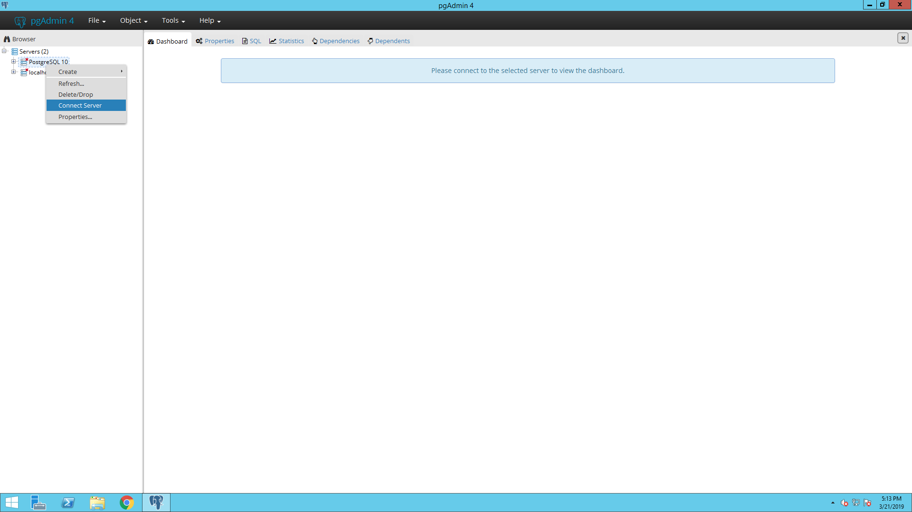
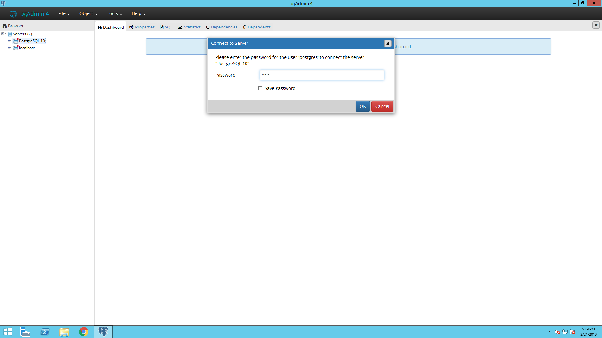
Mapping Source Codes – Your turn
Let’s open PostgreSQL
Open up pgAdmin4 using the icon on the task bar
Expand the server list and right-click on PostgreSQL 10 and choose Connect Server from the drop-down menu
When it asks for a password, type in ohdsi

Slide 69
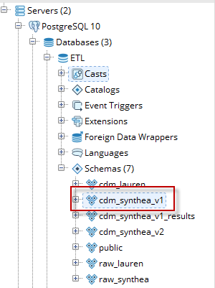
Mapping Source Codes – Your turn
Open up to and select the CDM (which has a copy of the vocab)
Tools → Query Tool
Type the following and hit F5 to run: SET SEARCH_PATH TO CDM_SYNTHEA_V1;

Slide 70

Mapping Source Codes – Your turn
CODE | DESCRIPTION | CODE TYPE
C83.3 | Diffuse large B-cell lymphoma | ICD10 (not ICD10CM)
?
?
CONDITION_CONCEPT_ID | CONDITION_SOURCE_CONCEPT_ID
https://github.com/OHDSI/Tutorial-ETL/tree/master/materials/Queries

Slide 71
Mapping Source Codes – Your turn
CODE | DESCRIPTION | CODE TYPE
C83.3 | Diffuse large B-cell lymphoma | ICD10 (not ICD10CM)
?
?
CONDITION_CONCEPT_ID | CONDITION_SOURCE_CONCEPT_ID
4300704 | 1567654
https://github.com/OHDSI/Tutorial-ETL/tree/master/materials/Queries

Slide 72
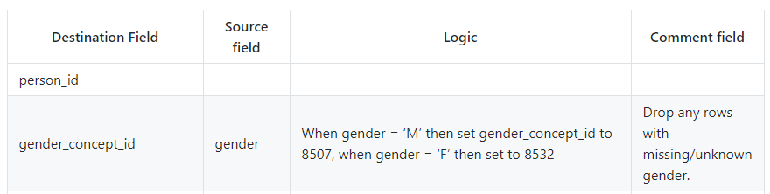
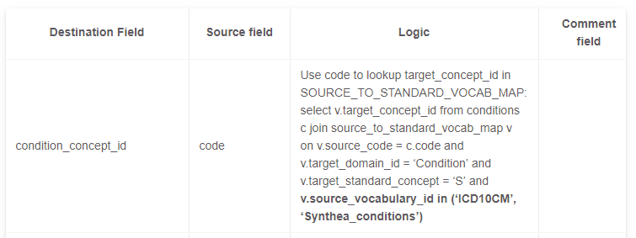
What do you do with the mapping information?
)
Notes:
Go back to the RIAH and drive home the idea of where the mapping information goes

Slide 73
Usagi
When the Vocabulary does not have your source codes you will need to create a map to OMOP Vocabulary Concepts
Usagi is Japanese for rabbit and was named after the first mapping exercise it was used for; mapping source codes used in a Japanese dataset into OMOP Vocabulary concepts
Usagi software tool to help with process of mapping source codes to OMOP concepts
Usagi performs text similarity between your source codes and what is in the OMOP Vocabulary

Slide 74
Usagi Process
Get a copy of the Vocabulary from ATHENA
Download Usagi
Have Usagi build an index on the Vocabulary
Load your source codes and let Usagi process them
Review and update suggest mappings with someone who has medical knowledge
Export codes into the SOURCE_TO_CONCEPT_MAP

Slide 75
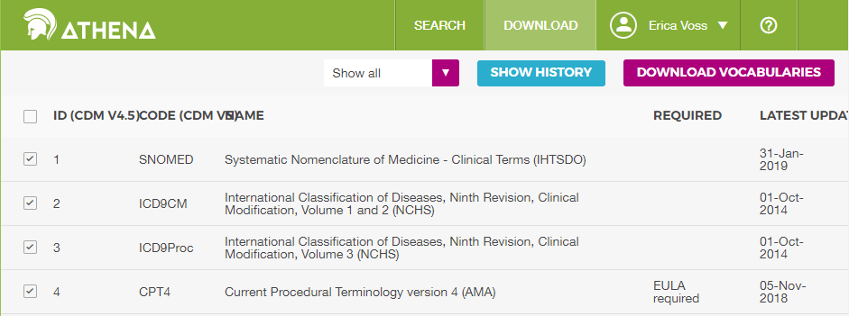
Usagi Process
1. Get a copy of the Vocabulary from ATHENA
http://athena.ohdsi.org

Slide 76
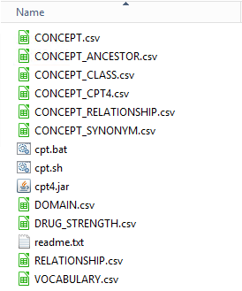
Usagi Process
1. Get a copy of the Vocabulary from ATHENA

Slide 77
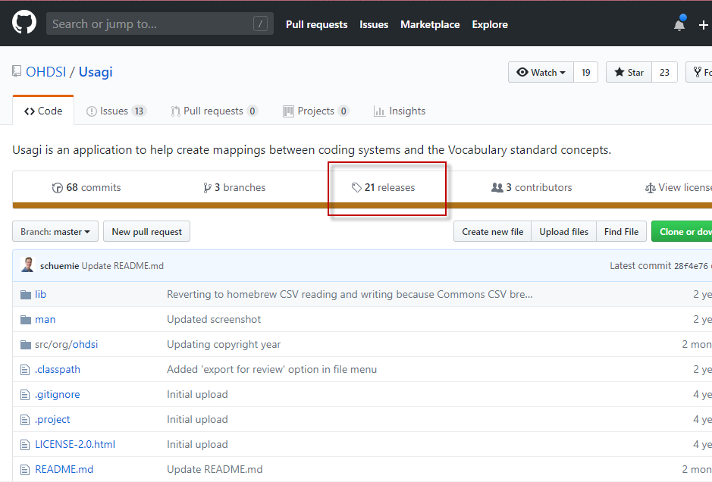
Usagi Process
2. Download Usagi
https://github.com/OHDSI/Usagi

Slide 78
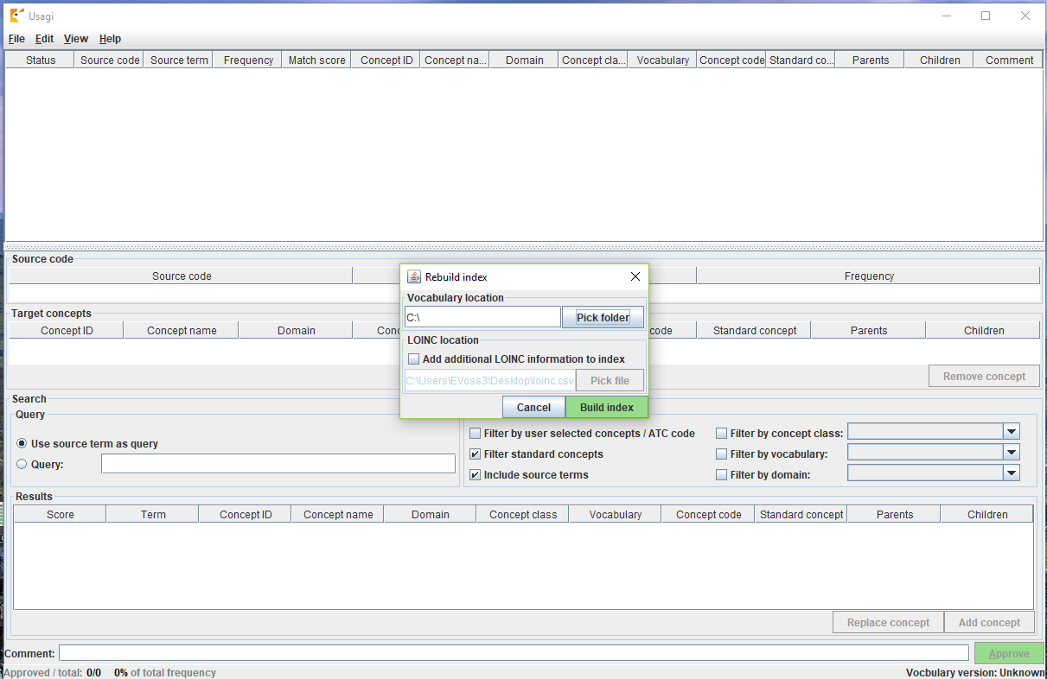
Usagi Process
3. Have Usagi build an index on the Vocabulary

Slide 79
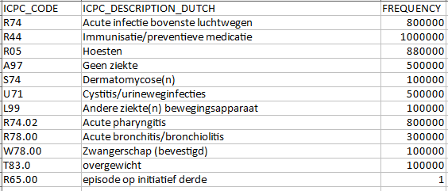
Usagi Process
4. Load your source codes, let Usagi process them
Generate an XLSX of distinct codes from source system with descriptions and frequency
If the codes are not in English, use Google Translate to convert

Slide 80

Usagi Process
4. Load your source codes, let Usagi process them
Import the codes into Usagi

Slide 81

Usagi Process
5. Review and update suggest mappings with someone who has medical knowledge

Slide 82
Usagi Process
5. Review and update suggest mappings with someone who has medical knowledge
Overview Table

Slide 83
Usagi Process
5. Review and update suggest mappings with someone who has medical knowledge
Selected Mapping

Slide 84
Usagi Process
5. Review and update suggest mappings with someone who has medical knowledge
Search Facility

Slide 85
Usagi Process
5. Review and update suggest mappings with someone who has medical knowledge
It may be valuable to sort on “Match Score”; reviewing codes that Usagi is most confident on first may quickly knock out a significant chunk of codes
Sorting on “Frequency” is valuable, spending more effort on frequent codes versus non-frequent is important
It is okay to map to zero or 0 – “No matching concept”
A source code might end up being mapped to two concepts
You might have what the system considers one domain but the OMOP Vocabulary lumps into another domain

Slide 86
Usagi Process
6. Export codes into the SOURCE_TO_CONCEPT_MAP
After you have completed, you will export the relationships
When exporting you will give a Vocabulary ID, for example JNJ_JMDC_PROVIDERS would signify a Johnson & Johnson map for the database JMDC for provider codes.
R74.02 - Acute pharyngitis = 25297 - Acute pharyngitis
source_ code | source_ concept_id | source_ vocab_id | source_ code_ description | target_ concept_ id | target_ vocab_id | valid_ start_date | valid_ end_ date | invalid_ reason
R74.02 | 0 | TEST_ VOCAB | Acute pharyngitis | 25297 | SNOMED | 1/1/1970 | 12/31/2099

Slide 87

Usagi Process
6. Export codes into the SOURCE_TO_CONCEPT_MAP
You then load your generated maps into the empty Vocabulary table.

Slide 88

Usagi – Your Turn
Get a copy of the Vocabulary from ATHENA
Download Usagi
Have Usagi build an index on the Vocabulary
Load your source codes and let Usagi process them
Review and update suggest mappings with someone who has medical knowledge
Export codes into the SOURCE_TO_CONCEPT_MAP

Slide 89

Now Your Turn: Open Usagi
Click on Usagi shortcut
Go into the Usagi-1.1.6 folder
Open Usagi.jar

Slide 90
Usagi – Your Turn
We have provided a small subset of codes to try to map
https://github.com/OHDSI/ Tutorial-ETL/
-> Materials -> Usagi -> DUTCH_ICPC_CONDITION_CODES_TO_MAP.xlsx
These condition codes are in Dutch ICPC codes and need to be mapped to standard concepts

Slide 91
Usagi – Your Turn
Your mission:
Download the codes to map
Translate codes to English
Import codes into Usagi
Map to standard concepts
Export SOURCE_TO_CONCEPT_MAP table
For help review the User Guide:
https://ohdsi.github.io/TheBookOfOhdsi/ExtractTransformLoad.html#usagi

Slide 92
Usagi – Your Turn
What CONCEPT_ID do you map “Dermatomycosis (s)” to?
USAGI Mapped:
We remapped to:
Source Term | Concept ID | Concept Name
Dermatomycosis (s) | 135473 | Dermatophytosis
a fungal infection of the skin, especially by a dermatophyte
a highly contagious, fungal infection of the skin or scalp (ringworm)
Source Term | Concept ID | Concept Name
Dermatomycosis (s) | 137213 | Dermal mycosis
a fungal infection of the skin, especially by a dermatophyte
fungal infection

Slide 93

Usagi – Your Turn

Slide 95




ETL Implementation
There are multiple tools available to implement your ETL
In this example we created a builder using SQL and R, though your choice will largely depend on the size and complexity of the ETL design

Slide 96





ETL Implementation
General Flow of Implementation
A good rule of thumb is to always create the PERSON table first
The VISIT_OCCURRENCE table must be created before the standardized clinical data tables as they all refer to the VISIT_OCCURRENCE_ID
Additional clinical data tables…
Notes:
It is a good idea to create the dimensional tables (PROVIDER, LOCATION, CARE_SITE) at the same time as PERSON

Slide 97
CDM Version 6 Key Domains
Person
Standardized health system data
Standardized metadata
Observation_period
CDM_source
Location
Standardized vocabularies
Visit_occurrence
Metadata
Location_history
Visit_detail
Standardized derived elements
Care_site
Condition_occurrence
Provider
Drug_exposure
Concept
Procedure_occurrence
Vocabulary
Device_exposure
Condition_era
Standardized clinical data
Domain
Drug_era
Measurement
Concept_class
Dose_era
Note
Standardized health economics
Concept_relationship
Results Schema
Note_NLP
Cohort
Relationship
Survey_conduct
Cohort_definition
Concept_synonym
Observation
Concept_ancestor
Specimen
Cost
Source_to_concept_map
Fact_relationship
Payer_plan_period
Drug_strength

Slide 98

ETL Implementation
First, let us review the logic we decided on for how the PERSON table should be created.
Navigate in your browser to: https://ohdsi.github.io/ETL-Synthea/Person.html

Slide 99




ETL Implementation
First, let’s review the logic we decided on for how the PERSON table should be created.
Gender:
Birthdate:
Race:
Ethnicity:

Slide 100
ETL Implementation
How should the PERSON table logic be implemented in SQL?
To open the query while we review:
https://github.com/OHDSI/Tutorial-ETL
Materials → Implementation→ Insert_Person_Lauren.sql
You can either view it directly in GitHub or download it and open it in pgAdmin4

Slide 101

ETL Implementation
How should the PERSON table logic be implemented in SQL?

Slide 102
ETL Implementation
Let’s review the logic we decided on for how the PERSON table should be created.
Gender:
Birthdate:
Race:
Ethnicity:

Slide 103
ETL Implementation
How should the PERSON table logic be implemented in SQL?
Gender
Notes:
What is missing from the gender portion in the sql code?

Slide 104
ETL Implementation
How should the PERSON table logic be implemented in SQL?
Gender
??

Slide 105

ETL Implementation
How should the PERSON table logic be implemented in SQL?
Gender
??

Slide 106
ETL Implementation
Let’s review the logic we decided on for how the PERSON table should be created.
Gender:
Birthdate:
Race:
Ethnicity:

Slide 107
ETL Implementation
How should the PERSON table logic be implemented in SQL?
Birthdate

Slide 108
ETL Implementation
How should the PERSON table logic be implemented in SQL?
Birthdate
??

Slide 109
ETL Implementation
Let’s review the logic we decided on for how the PERSON table should be created.
Gender:
Birthdate:
Race:
Ethnicity:

Slide 110
ETL Implementation
How should the PERSON table logic be implemented in SQL?
Race

Slide 111
ETL Implementation
Let’s review the logic we decided on for how the PERSON table should be created.
Gender:
Birthdate:
Race:
Ethnicity:

Slide 112
ETL Implementation
How should the PERSON table logic be implemented in SQL?
Ethnicity
??

Slide 113
ETL Implementation
Now let us run the code and create the PERSON table in the cdm_lauren schema
1. Download the query from:
https://github.com/OHDSI/Tutorial-ETL
Materials → Implementation→ Insert_Person_Lauren.sql
2. Open up pgAdmin4 using the icon on the task bar
Notes:
Open up pgAdmin 4 on the VM

Slide 114
ETL Implementation
Expand the server list and right-click on PostgreSQL 10 and choose Connect Server from the drop-down menu
When it asks for a password, type in ohdsi

Slide 115

ETL Implementation
Open up to and select the CDM (which has a copy of the vocab)
Tools → Query Tool
Type the following and hit F5 to run: SET SEARCH_PATH TO CDM_LAUREN;

Slide 116

ETL Implementation
Paste the sql code to create the PERSON table into the query window and press F5 or
NOTE:
The ‘truncate’ statement at the beginning deletes anything that is in the table already without deleting the table itself (helpful if you make a mistake)
QUESTIONS:
How would you check that your PERSON table was created?
How could you fix the ethnicity mapping?

Slide 117

ETL Implementation
Data Quality at implantation – ethnicity correction
Ethnicity

Slide 118

Build the rest of the tables . . .
github.com/ohdsi/ETL-synthea

Slide 119
Resources
The full Synthea builder can be found here:
https://github.com/OHDSI/ETL-Synthea
Another example of a R/SQL builder for a much larger database:
https://github.com/OHDSI/ETL-HealthVerityBuilder
A builder created using .NET:
https://github.com/OHDSI/ETL-CDMBuilder
A builder created using the AWS lambda functionality:
https://github.com/OHDSI/ETL-lambdabuilder
(in development)

Slide 120
Example Builder 1: Janssen CDM Builder Over Time
Simple
Simple SQL Queries
Sophisticated
C# Single Machine
Simple SQL Queries + Cursors
SAS Builder
C# Multiple Machine
C# in Cloud Enabled Environment
Data Experts & CDM Experts
Data Experts & CDM Experts
Technical Experts
https://github.com/OHDSI/ETL-CDMBuilder

Slide 121


Example Builder 2: PEDSnet
Data Coordinating Center: Children’s Hospital of Philadelphia (CHOP)
PEDSnet (n=6.2 million patients)
8 contributing sites

Slide 122

CHOP
Children’s Hospital of Philadelphia
Data Coordinating Center (quarterly submissions)
PEDSnet DDL
ETL Conventions
Data Quality
Data Science
Also, a submitting site:
~ 1.2 million patients
~ 55 million visits
~ 700 million clinical facts

Slide 123
CHOP ETL Flow –More like LTE
L
Load (very little re-organization of data)
T
Transform (Mapping of concepts, remapping ETL)
E
Extract to final PEDSnet (OMOP-like) tables
Staging Tables
Epic Clarity
Staging Postgres DB
Final Tables

Slide 124
Challenges/Lessons Learned
We ultimately have to make decisions about our data:
What do we include?
Cancelled visits with associated information, reflects known workflow for research visits
What data do we exclude?
Cancelled Labs, Procedures
Test patients
Patients with lab only data (Adults lab/blood work, genetics)
Who makes these decisions?
Data Committee/Data Modeling Working Group
Local Informaticist and Analyst team

Slide 125
Challenges/Lessons Learned
Our ETL is time-constraint due to clinical system ETL
Structured program to take into account midnight system wide shutdown for ETL
Clinical data does not always fit OMOP rules
Multivitamin prescriptions with 2055 `end_date`
Fetal Procedures `procedure_start_date` before `birth_date`
Autopsies procedures `procedure_start_date` after `death_date`
Multiple “encounters” associated with one visit
Intermediate/Temporary tables are crucial for debugging
Tables containing source identification numbers (IDS such as MRNS, patient ids, source system ids) alongside OMOP data before “final version”

Slide 126

Data Validation: Data Model Validator
Validates table structures and data types
Prompts user to specify the model and version number
Alerts if there are any unexpected columns and/or tables
https://github.com/infomodels/infomodels (OMOP model supported)

Slide 127

Data Validation: Data Quality Framework
Automated Program where issues are flagged as GitHub issues categorized by table, domain and priority (High, Medium, Low)
Checks fall into the following categories:
Fidelity/Reliability: Is this data correct? Is it being coded/mapped correctly?
Consistency/Internal Validity: Are there any drops/inconsistencies between submissions?
Accuracy: Does the data correctly reflect clinical characteristics of patients?
Completeness : Is there data that is missing?
https://pedsnet.org/data/data-quality/

Slide 129


Quality
What tools are available to check that the CDM logic was implemented correctly?
Rabbit-in-a-Hat Test Case Framework
Achilles
DataQualityDashboard (DQD)

Slide 130
Unit Test Cases
Testing your CDM builder is important:
ETL often complex, increasing the danger of making mistakes that go unnoticed
CDM can update
Source data structure/contents can change over time
Rabbit-In-a-Hat can construct unit test, or small pieces of code that can automatically check single aspects of the ETL design

Slide 131

Unit Test Cases
Rabbit-in-a-Hat
The application has a feature called ‘Generate ETL Test Framework’. This feature allows you to create ‘fake’ people as a way to test your ETL logic.

Slide 132

Unit Test Cases
The test framework creates a series of R functions that enables you to specify your ‘fake’ people and records in the same structure as your source data using the scan report as a guide.

Slide 133


Unit Test Cases

Slide 134
Unit Test Cases
An example of how this was done for the Synthea data is available from: https://github.com/OHDSI/Tutorial-ETL/tree/master/materials/Unit%20Tests
The file that creates the test cases as a series of insert statement is RunSyntheaTestCases.r
Notes:
Pull up the test cases on the VM

Slide 135

Unit Test Cases
Let us revisit the PERSON table logic:
How could we create a test case for this?
Notes:
Pull up the test cases on the VM, this can be for reference

Slide 136
Achilles
Achilles is a data characterization and quality tool available for download here:
https://github.com/OHDSI/Achilles
For an example of how it was run for our sample data, that R script is located here:
https://github.com/OHDSI/Tutorial-ETL/blob/master/materials/Achilles/achillesRun.R
Notes:
Pull up achilles on the VM to explore

Slide 137

Achilles

Slide 138

Achilles
This plot shows that the bulk of the data starts in 2005. However, there also appear to be a few records from around 1961, which is likely an error in the data.

Slide 139

Achilles
This change coincides with changes in the reimbursement rules in this specific country, leading to more diagnoses but probably not a true increase in prevalence in the underlying population.

Slide 140

Achilles Heel
Achilles heel is a report generated by the Achilles application that will run a series of data quality checks on the CDM using the Achilles data

Slide 141

DataQualityDashboard (DQD)
Runs a prespecified set of data quality checks and thresholds on the CDM

Slide 142

DQD Example Rules

Slide 143

Issues in our synthetic data?
Did our test cases run?
cdm_synthea

Slide 144

Issues in our synthetic data?
Did Achilles notice anything?
cdm_synthea

Slide 145

Issues in our synthetic data?
Did DQD notice anything?
cdm_synthea

Slide 146


Maybe we have a bug?
In the CONDITION_OCCURRENCE, 61% rows are mapped to 0

Slide 147

ETL Maintenance
ETL Documentation
Changed or Updated Raw Data?
ETL
Bug Found?
Updated CDM
New Vocab?
All are involved in quality control
A technical person implements the ETL
CDM Update?

Slide 148

Document the Bug

Slide 149

Vocabulary to fix the problem

Slide 150
Vocabulary to fix the problem
WITH CTE_VOCAB_MAP AS (
SELECT c.concept_code AS SOURCE_CODE, c.concept_id AS SOURCE_CONCEPT_ID, c.concept_name AS SOURCE_CODE_DESCRIPTION,
c.vocabulary_id AS SOURCE_VOCABULARY_ID, c.domain_id AS SOURCE_DOMAIN_ID, c.CONCEPT_CLASS_ID AS SOURCE_CONCEPT_CLASS_ID,
c.VALID_START_DATE AS SOURCE_VALID_START_DATE, c.VALID_END_DATE AS SOURCE_VALID_END_DATE, c.INVALID_REASON AS SOURCE_INVALID_REASON, c1.concept_id AS TARGET_CONCEPT_ID, c1.concept_name AS TARGET_CONCEPT_NAME, c1.VOCABULARY_ID AS TARGET_VOCABUALRY_ID,
c1.domain_id AS TARGET_DOMAIN_ID, c1.concept_class_id AS TARGET_CONCEPT_CLASS_ID, c1.INVALID_REASON AS TARGET_INVALID_REASON, c1.standard_concept AS TARGET_STANDARD_CONCEPT
FROM CONCEPT C
JOIN CONCEPT_RELATIONSHIP CR
ON C.CONCEPT_ID = CR.CONCEPT_ID_1
AND CR.invalid_reason IS NULL
AND cr.relationship_id = 'Maps to'
JOIN CONCEPT C1
ON CR.CONCEPT_ID_2 = C1.CONCEPT_ID
AND C1.INVALID_REASON IS NULL
UNION
SELECT source_code, SOURCE_CONCEPT_ID, SOURCE_CODE_DESCRIPTION, source_vocabulary_id, c1.domain_id AS SOURCE_DOMAIN_ID, c2.CONCEPT_CLASS_ID AS SOURCE_CONCEPT_CLASS_ID,c1.VALID_START_DATE AS SOURCE_VALID_START_DATE,
c1.VALID_END_DATE AS SOURCE_VALID_END_DATE, stcm.INVALID_REASON AS SOURCE_INVALID_REASON,target_concept_id,
c2.CONCEPT_NAME AS TARGET_CONCEPT_NAME, target_vocabulary_id, c2.domain_id AS TARGET_DOMAIN_ID,
c2.concept_class_id AS TARGET_CONCEPT_CLASS_ID, c2.INVALID_REASON AS TARGET_INVALID_REASON,
c2.standard_concept AS TARGET_STANDARD_CONCEPT
FROM source_to_concept_map stcm
LEFT OUTER JOIN CONCEPT c1
ON c1.concept_id = stcm.source_concept_id
LEFT OUTER JOIN CONCEPT c2
ON c2.CONCEPT_ID = stcm.target_concept_id
WHERE stcm.INVALID_REASON IS NULL
)
SELECT TARGET_CONCEPT_ID, TARGET_CONCEPT_NAME, TARGET_DOMAIN_ID
FROM CTE_VOCAB_MAP
WHERE SOURCE_VOCABULARY_ID = ‘Synthea_conditions'
Look in the Source to Concept Map table for a map

Slide 151
Update the ETL document
https://ohdsi.github.io/Tutorial-ETL/docs/cdm_synthea_v2

Slide 152

Re-run the DQD
TBD

Slide 153


Re-run Achilles

Slide 154

Final Hard Lessons Learned

Slide 155


80/20 Rule
You don’t need to map all terms to get good data coverage!

Slide 156
Comfort with Data Loss
If there is data that is not of research quality or there are methods to adjust, use the ETL to standardize that
Example Patient Drop Counts from a CDM Build
Reason to Drop Someone | Person Count
Unknown gender | 23,592
Implausible year of birth - past | 749
Implausible year of birth - post earliest observation period | 3,836
Gender changes | 2

Slide 157
ETL Process
ETL Documentation
ETL
Data experts and CDM experts together design the ETL
People with medical knowledge create the code mappings
All are involved in quality control
A technical person implements the ETL
OHDSI Tools
White
Rabbit
Rabbit In a Hat
Usagi
White
Rabbit
ACHILLES
DQD
Rabbit In a Hat

Slide 158
ETL Maintenance
ETL Documentation
Changed or Updated Raw Data?
ETL
Bug Found?
Updated CDM
New Vocab?
All are involved in quality control
A technical person implements the ETL
CDM Update?

Slide 159


Thank you!
This tutorial would not have been possible without the contribution of many collaborators in the OHDSI Community
We like to thank Amazon Web Services for their valuable technical support and resources

Slide 160



Acknowledgements
Anthony Molinaro who wrote the Synthea CDM Builder
James Wiggins who helps us prepare an AWS instance for use today
Pusheen the Cat
http://pusheen.com/

Slide 161


